Slide 1
Secure Collaboration using Enhanced Federated Learning FedFusion
By Muhammad Saadan, Misbah Juwayriyyah, Wasif Mehmood

Slide 2
Contents
01
02
03
04
Overview
Features and Modules
Brief description of modules.
Already Implemented Features and future considerations.
Pipeline and Results
Platform
Results of the implementation.
User Interface and front-end.

Slide 3

01
Overview
Our Platform

Slide 4
Introduction
FedFusion is a platform to experiment and perform decentralized model training keeping data private and secure. Not a framework but an actual application to provide federated learning experience.
FedFusion not only offers mere federated training functionality but enhanced security. Added security using encryption and state-of-art attack demonstrations (from a research perspective).

Slide 5
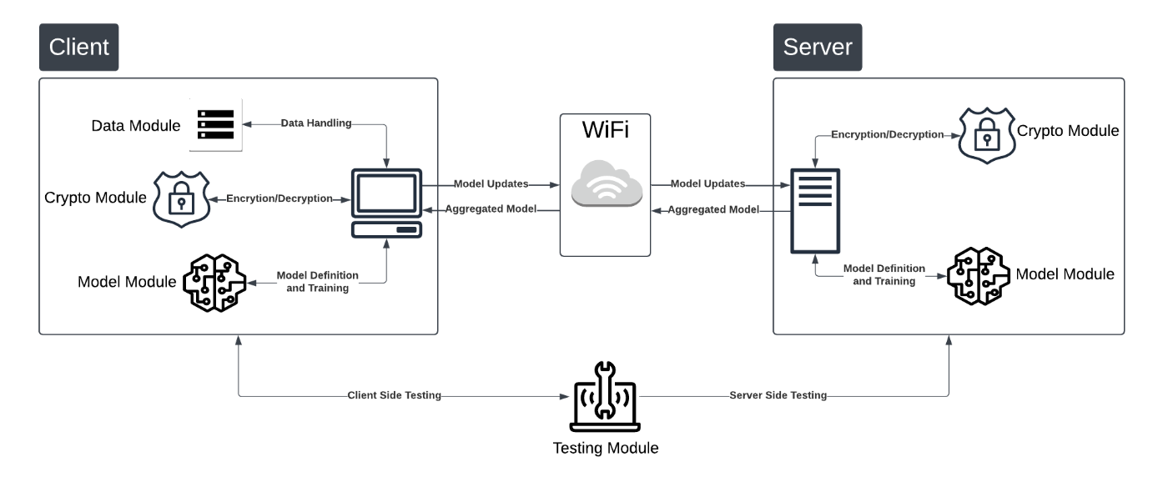
Architecture

Slide 6
02
Features and Modules
Current System State and Progress

Slide 7
Modules…
Anomaly Detection
Server
A server side module with a Customised Federated Average Strategy for model aggregation
Metrics + Logs
Aggregation

Slide 8
Modules…
Attack Visualizations
Client
A client-side module that handles data preprocessing. It also provides demonstration of SOTA Attacks.
Data Handling + Logs
Encrypted Updates

Slide 9
Modules…
Data Loading
Data
Provides preprocessing of data (image based).
Preprocessing
Partitioning

Slide 10
Modules…
Attack
Data Poisoning
Lets user perform state-of-art attacks and view the experimental results.
Data Recovery

Slide 11
Modules…
Models
CNN for Images
Provided inbuilt support for two custom models CNN and LSTM.
LSTM for Text

Slide 12
Modules…
Crypto
AES Key
Provides added encryption for model communication between server and client.
RSA Algorithm

Slide 13
03
Pipeline and Results
Flow of the system and implementation results

Slide 14
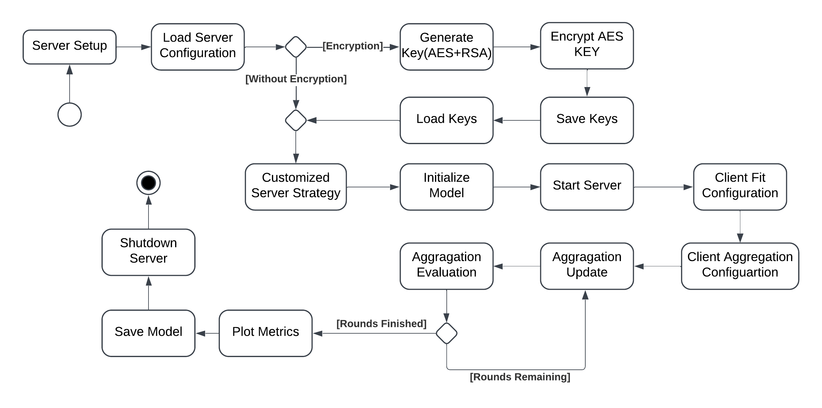
Pipeline (Server)

Slide 15
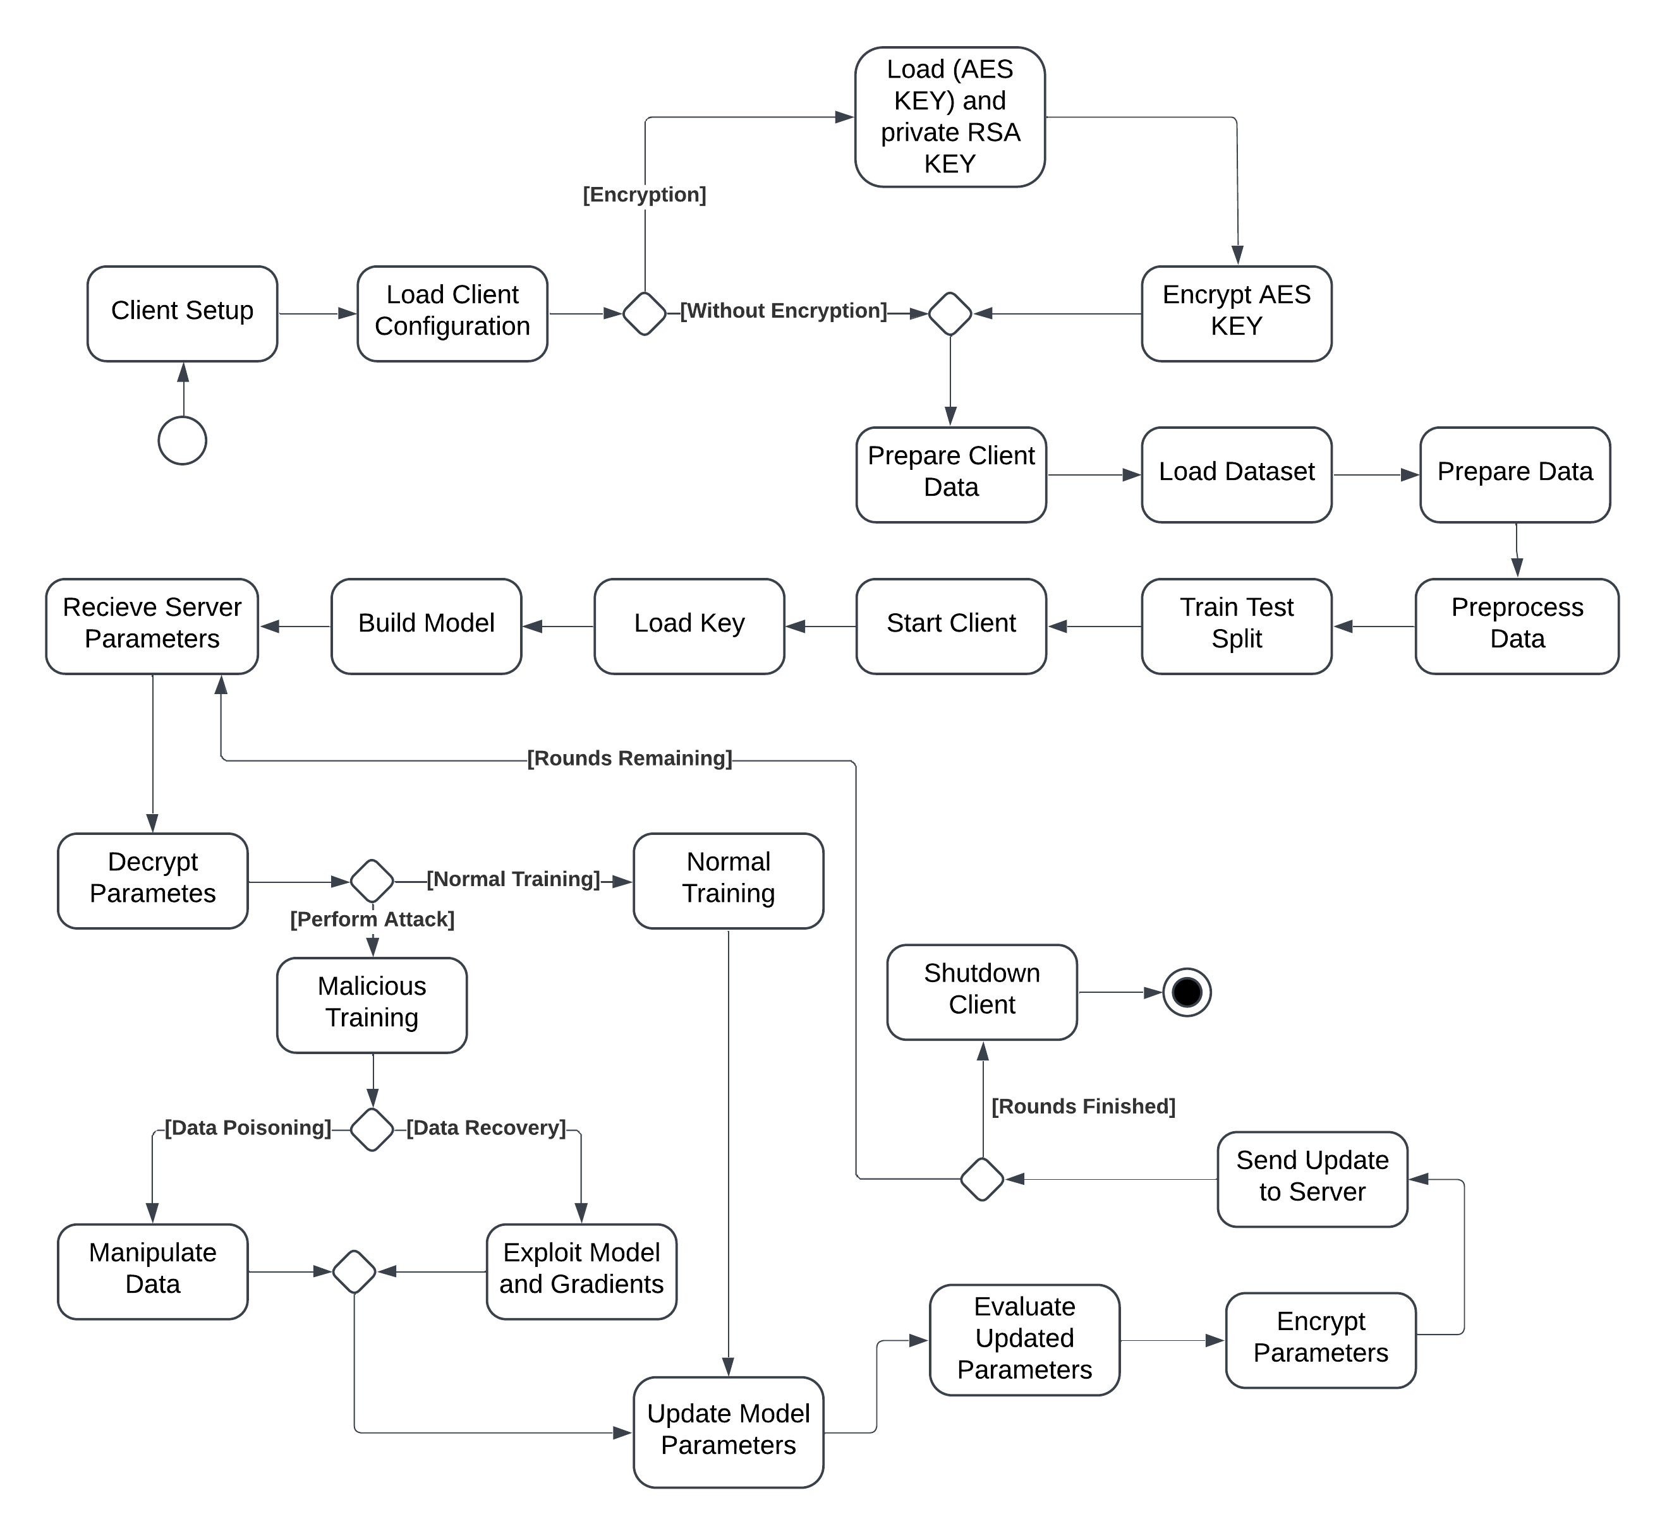
Pipeline (Client)

Slide 16
Results?
Training
Attacks
For comparison to past reasearch, training results on Cifar10.
Data Poisoning Attack and Data Recovery Attack

Slide 17
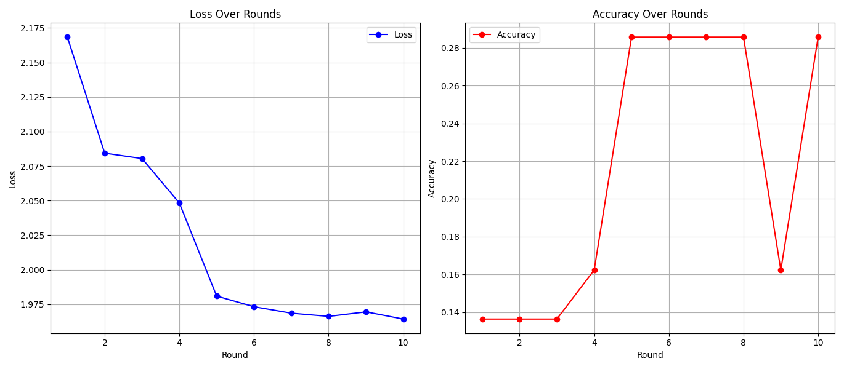
Training Results
Training results on Cifar10 without anomoly detection.
Example: 10 Rounds, 2 Clients

Slide 18
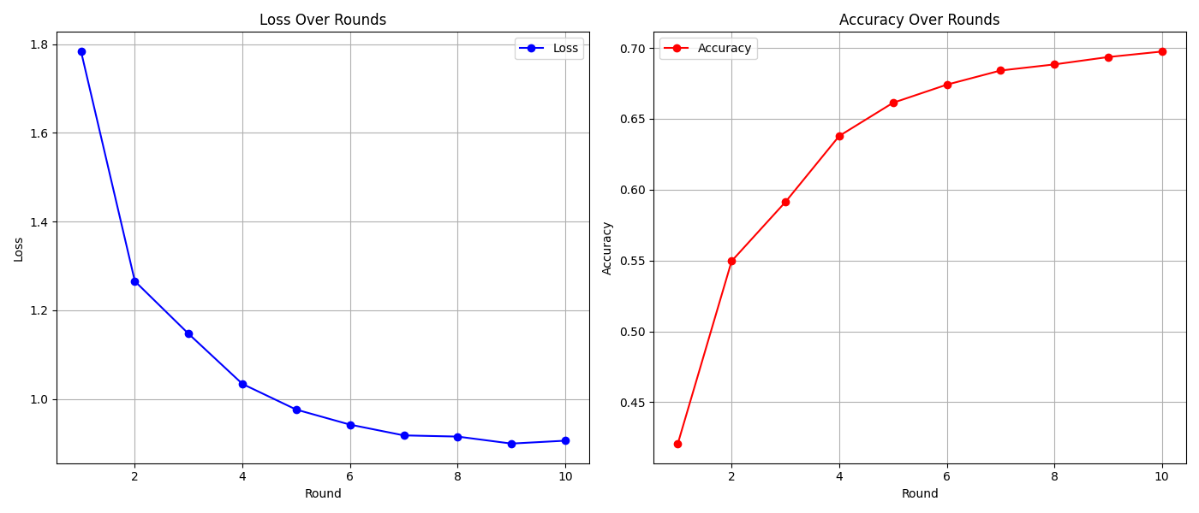
Training Results
Training on Cifar10 with anomoly detection
Example: 10 Rounds, 2 Clients

Slide 19
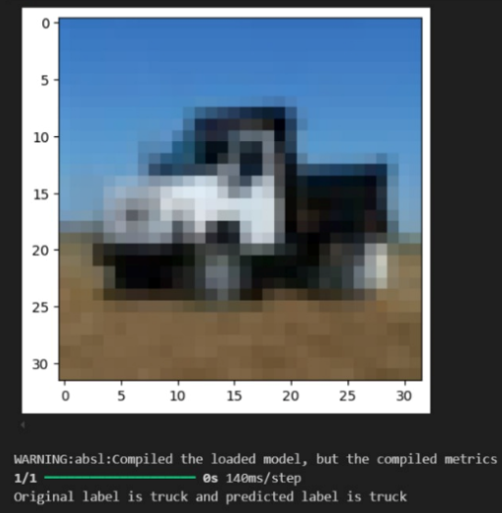
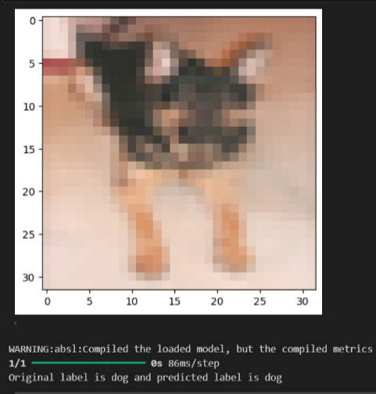
Training Results
Model Inference for validation
Example: 10 Rounds, 2 Clients

Slide 20
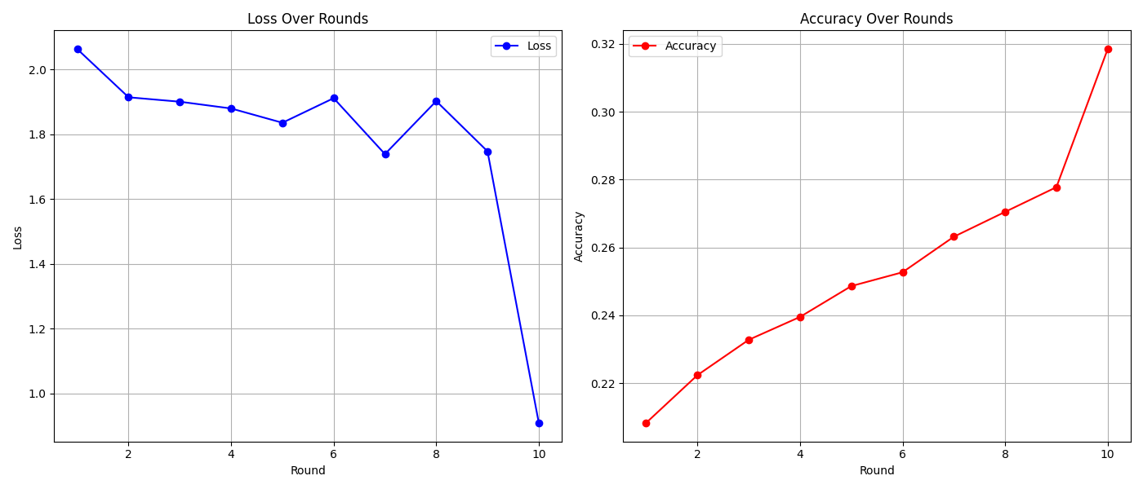
Attack Results
Data Poisoning Attack through compromised node.
Example: 10 Rounds, 2 Clients

Slide 21
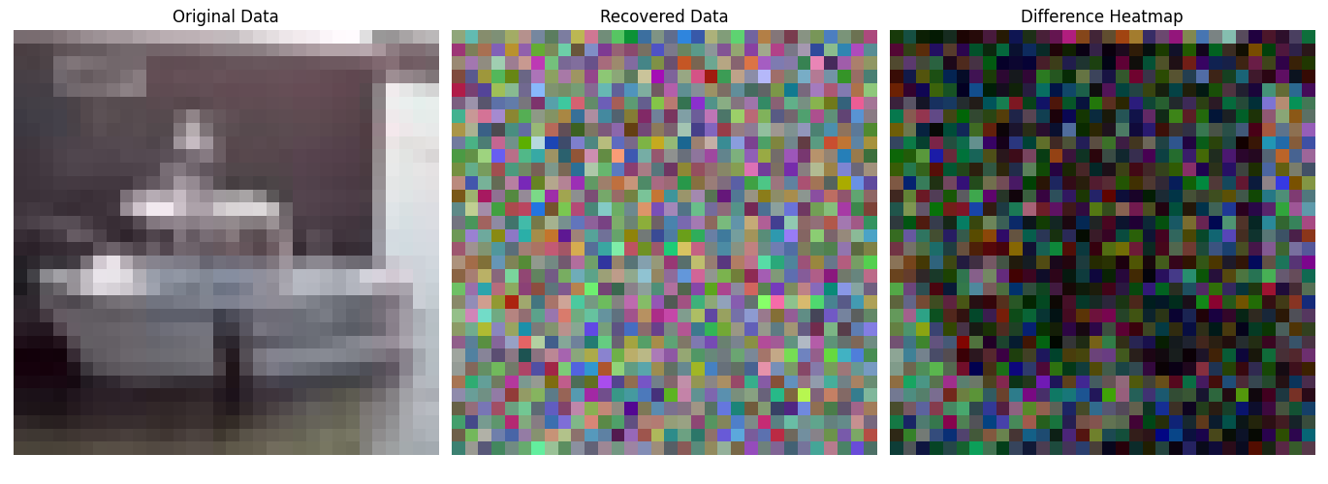
Attack Results
Data Recovery Attack on Cifar 10. Experimental Needs Improvement. Example: 10 Rounds, 2 Clients

Slide 22
04
Platform
User Interface and our front-end

Slide 23

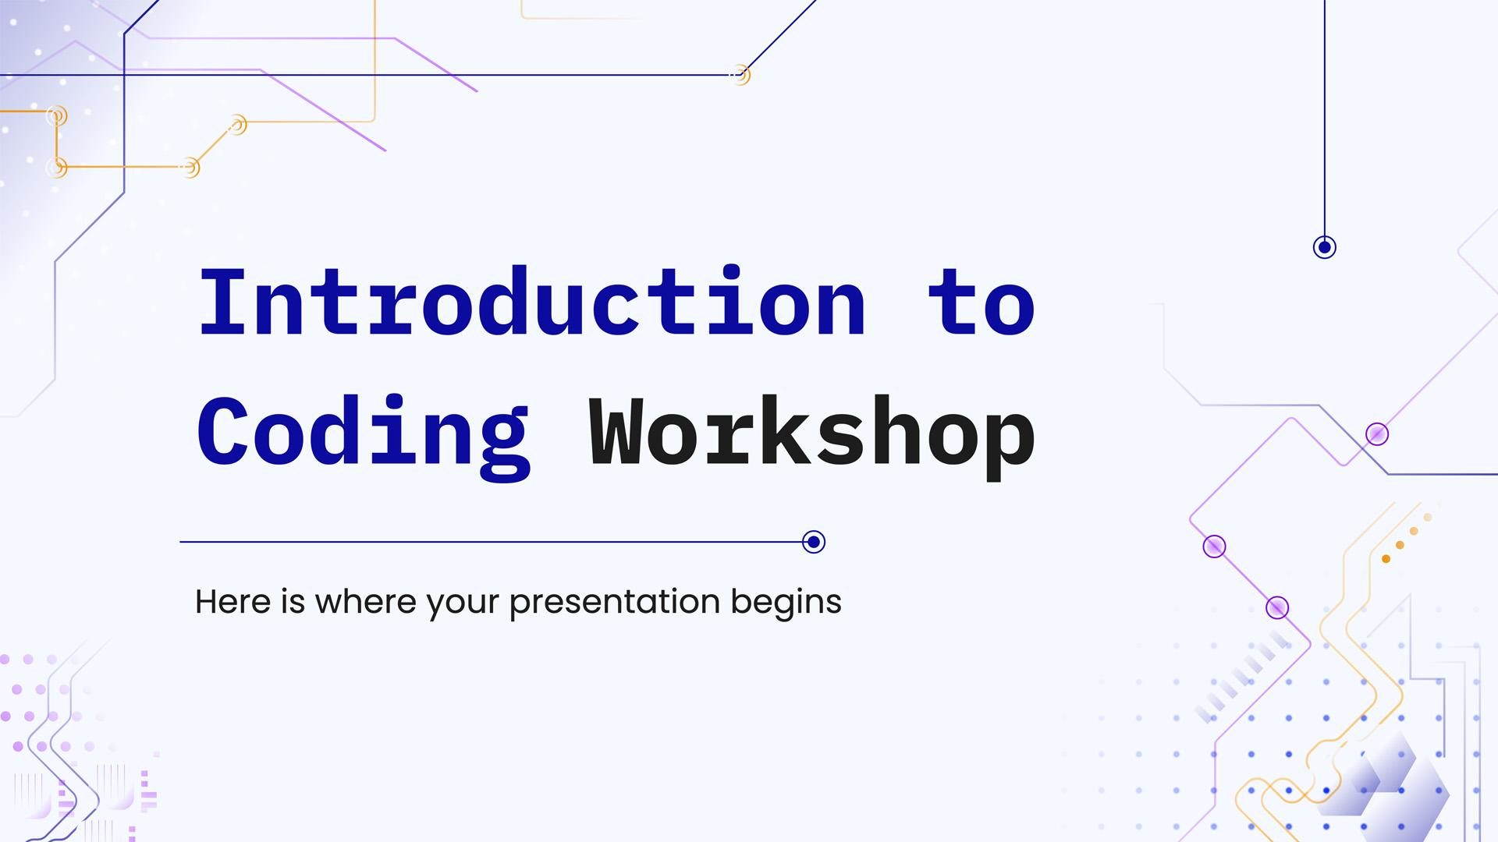
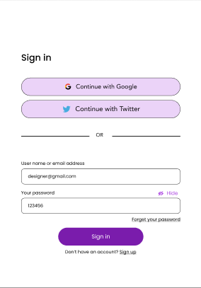
User Interface
Our front-end design

Slide 24
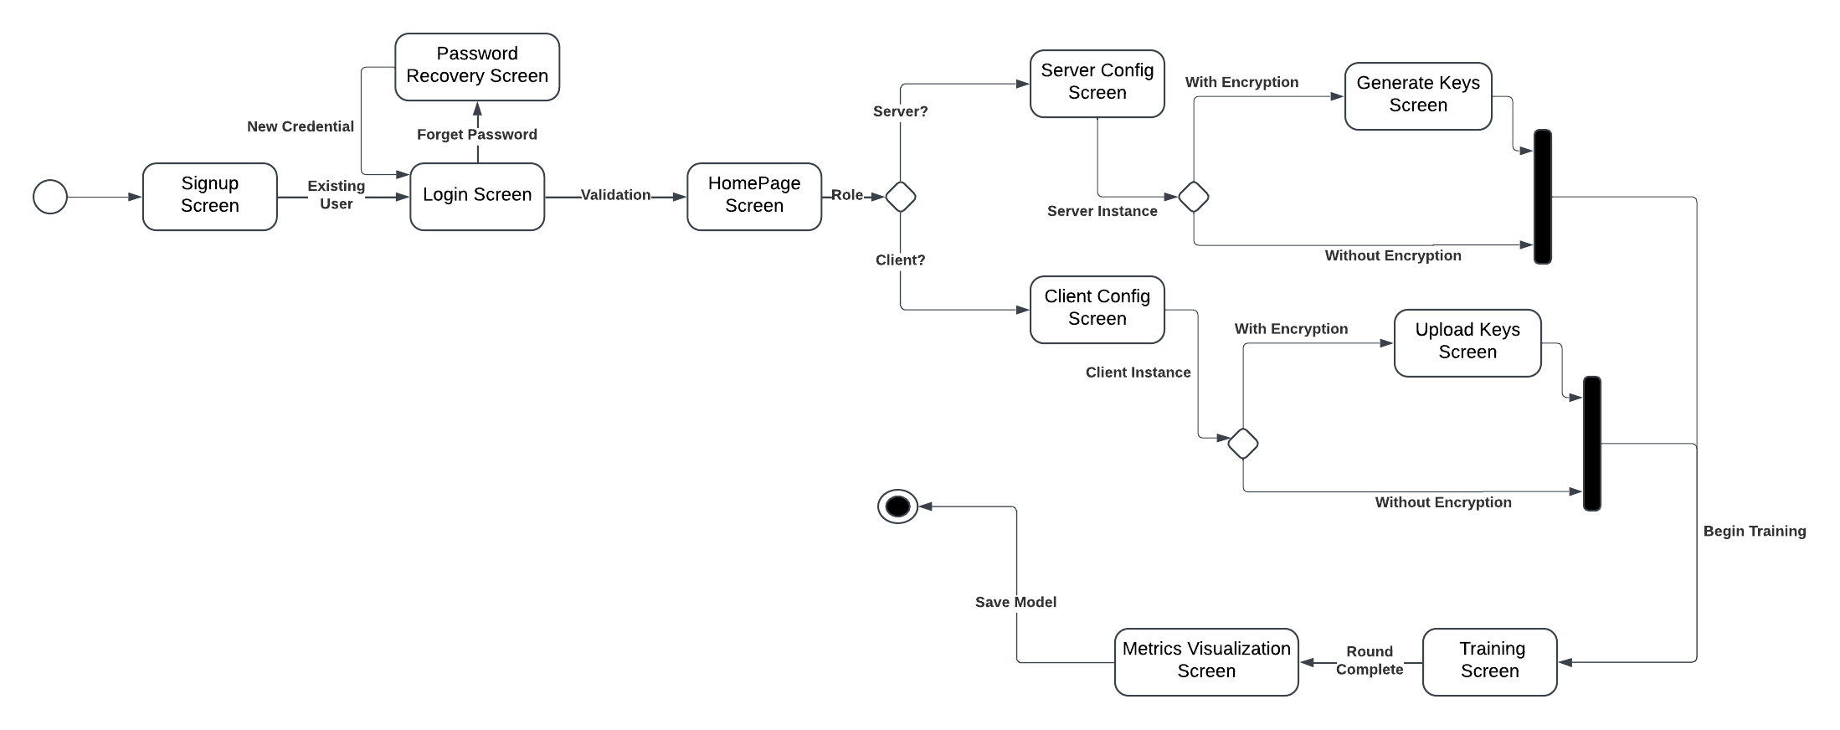
Flow

Slide 25
Work in Progress
Integration
Automation
Integration of backend with the frontend
Automation of data and configuration variables
Testing
Research
User Experience Testing
Replicate research and improve baseline results

Slide 26
Thanks!
Do you have any questions?
FedFusion

